Slide 1
Agile Model

Slide 2
The meaning of Agile is swift or versatile. "Agile process model" refers to a software development approach based on iterative development. Agile methods break tasks into smaller iterations, or parts do not directly involve long term planning. The project scope and requirements are laid down at the beginning of the development process. Plans regarding the number of iterations, the duration and the scope of each iteration are clearly defined in advance.
Each iteration is considered as a short time "frame" in the Agile process model, which typically lasts from one to four weeks. The division of the entire project into smaller parts helps to minimize the project risk and to reduce the overall project delivery time requirements. Each iteration involves a team working through a full software development life cycle including planning, requirements analysis, design, coding, and testing before a working product is demonstrated to the client.

Slide 3
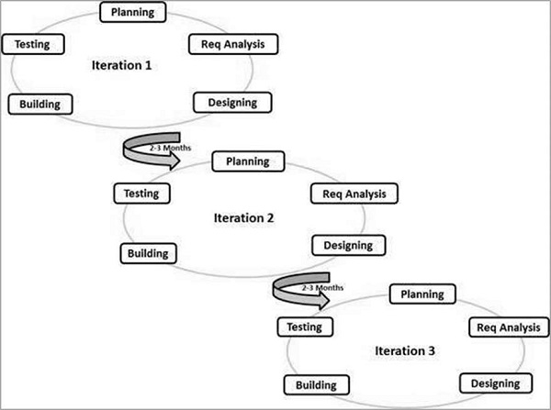

Slide 4
Phases of Agile Model:
Following are the phases in the Agile model are as follows:
Requirements gathering
Design the requirements
Construction/ iteration
Testing/ Quality assurance
Deployment
Feedback

Slide 5
Agile Testing Methods:
Scrum
Crystal
Dynamic Software Development Method(DSDM)
Feature Driven Development(FDD)
Lean Software Development
eXtreme Programming(XP)

Slide 6
Scrum
SCRUM is an agile development process focused primarily on ways to manage tasks in team-based development conditions.
There are three roles in it, and their responsibilities are:
Scrum Master: The scrum can set up the master team, arrange the meeting and remove obstacles for the process
Product owner: The product owner makes the product backlog, prioritizes the delay and is responsible for the distribution of functionality on each repetition.
Scrum Team: The team manages its work and organizes the work to complete the sprint or cycle.

Slide 7
eXtreme Programming(XP)
This type of methodology is used when customers are constantly changing demands or requirements, or when they are not sure about the system's performance.
Crystal:
There are three concepts of this method-
Chartering: Multi activities are involved in this phase such as making a development team, performing feasibility analysis, developing plans, etc.
Cyclic delivery: under this, two more cycles consist, these are:
Team updates the release plan.
Integrated product delivers to the users.
Wrap up: According to the user environment, this phase performs deployment, post-deployment.

Slide 8
Dynamic Software Development Method(DSDM):
DSDM is a rapid application development strategy for software development and gives an agile project distribution structure. The essential features of DSDM are that users must be actively connected, and teams have been given the right to make decisions. The techniques used in DSDM are:
Time Boxing
MoSCoW Rules
Prototyping
The DSDM project contains seven stages:
Pre-project
Feasibility Study
Business Study
Functional Model Iteration
Design and build Iteration
Implementation
Post-project

Slide 9
Feature Driven Development(FDD):
This method focuses on "Designing and Building" features. In contrast to other smart methods, FDD describes the small steps of the work that should be obtained separately per function.
Lean Software Development:
Lean software development methodology follows the principle "just in time production." The lean method indicates the increasing speed of software development and reducing costs. Lean development can be summarized in seven phases.
Eliminating Waste
Amplifying learning
Defer commitment (deciding as late as possible)
Early delivery
Empowering the team
Building Integrity
Optimize the whole

Slide 10
Scrum (software development)
Scrum is the type of Agile framework. It is a framework within which people can address complex adaptive problem while productivity and creativity of delivering product is at highest possible values. Scrum uses Iterative process. Silent features of Scrum are:
Scrum is light-weighted framework
Scrum emphasizes self-organization
Scrum is simple to understand
Scrum framework help the team to work together

Slide 11
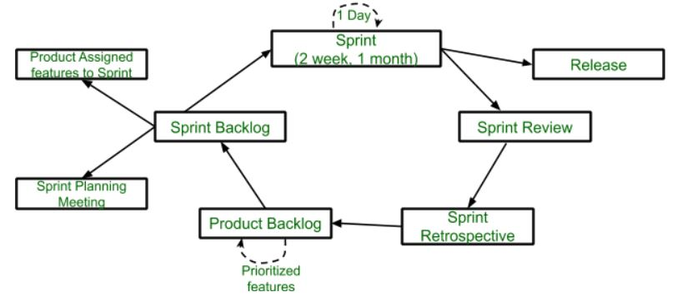

Slide 12
Sprint: A Sprint is a time box of one month or less. A new Sprint starts immediately after the completion of the previous Sprint. Release: When the product is completed, it goes to the Release stage. Sprint Review: If the product still has some non-achievable features, it will be checked in this stage and then passed to the Sprint Retrospective stage. Sprint Retrospective: In this stage quality or status of the product is checked. Product Backlog: According to the prioritize features the product is organized. Sprint Backlog: Sprint Backlog is divided into two parts Product assigned features to sprint and Sprint planning meeting.

Slide 13
Advantage of using Scrum framework:
Scrum framework is fast moving and money efficient.
Scrum framework works by dividing the large product into small sub-products. It’s like a divide and conquer strategy
In Scrum customer satisfaction is very important.
Scrum is adaptive in nature because it have short sprint.
As Scrum framework rely on constant feedback therefore the quality of product increases in less amount of time
Disadvantage of using Scrum framework:
Scrum framework do not allow changes into their sprint.
Scrum framework is not fully described model. If you wanna adopt it you need to fill in the framework with your own details like Extreme Programming(XP), Kanban, DSDM.
It can be difficult for the Scrum to plan, structure and organize a project that lacks a clear definition.
The daily Scrum meetings and frequent reviews require substantial resources.

Slide 14
RAD (Rapid Application Development) Model
RAD (Rapid Application Development) is a concept that products can be developed faster and of higher quality through:
Gathering requirements using workshops or focus groups
Prototyping and early, reiterative user testing of designs
The re-use of software components
A inflexibly paced schedule that refers design improvements to the next product version
Less formality in reviews and other team communication
Notes:
The Rapid Application Development (or RAD) model is based on prototyping and iterative model with no (or less) specific planning. In general, RAD approach to software development means putting minor importance on planning tasks and more importance on development and coming up with a prototype

Slide 15
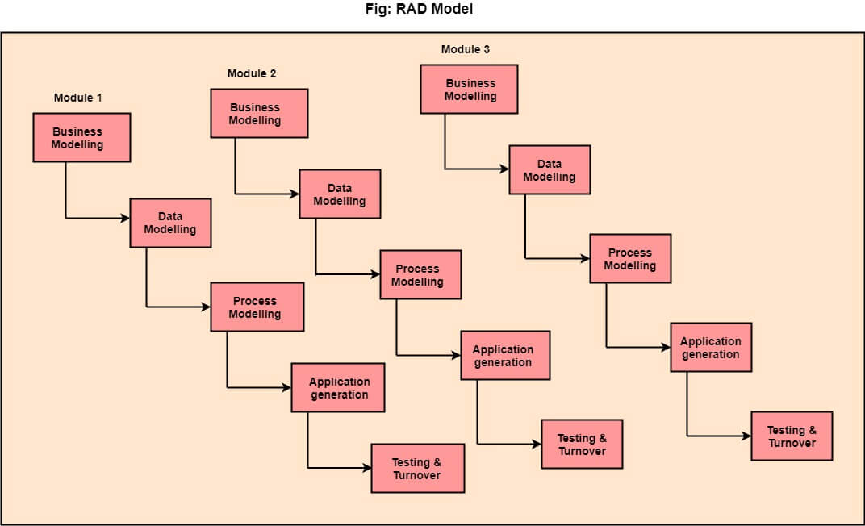

Slide 16
The various phases of RAD are as follows:
1.Business Modelling: The information flow among business functions is defined by answering questions like what data drives the business process, what data is generated, who generates it, where does the information go, who process it and so on.
2. Data Modelling: The data collected from business modeling is refined into a set of data objects (entities) that are needed to support the business. The attributes (character of each entity) are identified, and the relation between these data objects (entities) is defined.
3. Process Modelling: The information object defined in the data modeling phase are transformed to achieve the data flow necessary to implement a business function. Processing descriptions are created for adding, modifying, deleting, or retrieving a data object.
4. Application Generation: Automated tools are used to facilitate construction of the software; even they use the 4th GL techniques.
5. Testing & Turnover: Many of the programming components have already been tested since RAD emphasis reuse. This reduces the overall testing time. But the new part must be tested, and all interfaces must be fully exercised.
When to use RAD Model?
When the system should need to create the project that modularizes in a short span time (2-3 months).
When the requirements are well-known.
When the technical risk is limited.
When there's a necessity to make a system, which modularized in 2-3 months of period.
It should be used only if the budget allows the use of automatic code generating tools.

